Slide 1

EUROS 2024
EXL HACKATHON 2024
TEAM YAAY - ABHISHEK THOMAS, ALOK KUMAR, YASH AGARWAL, YOGESH YADHAV

Slide 2
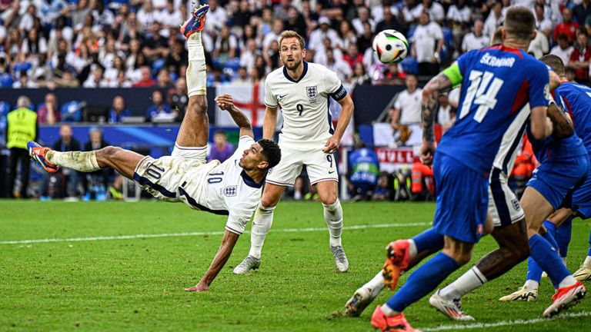
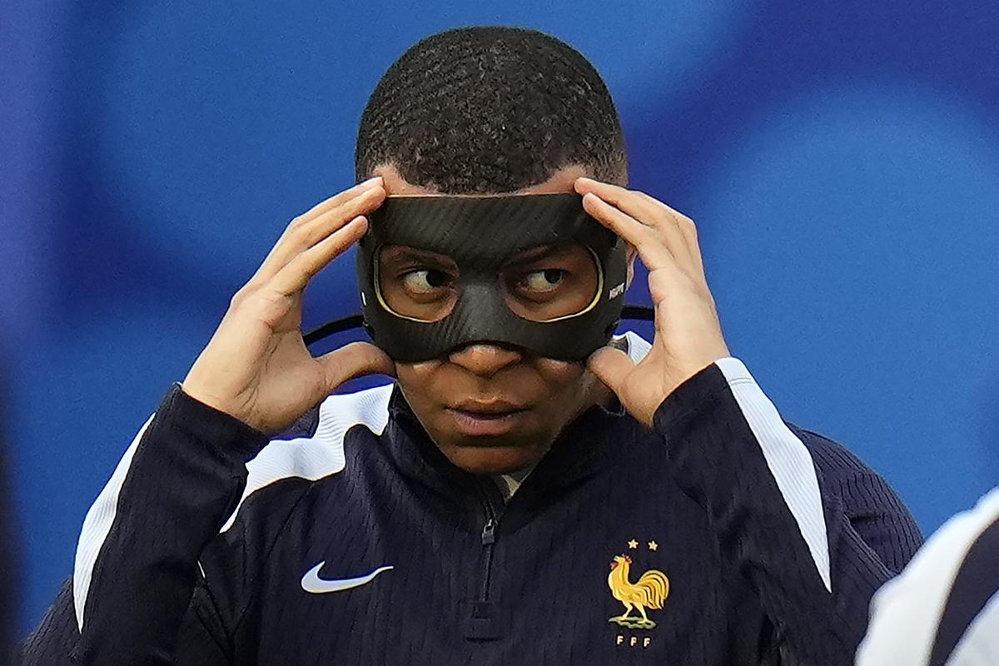
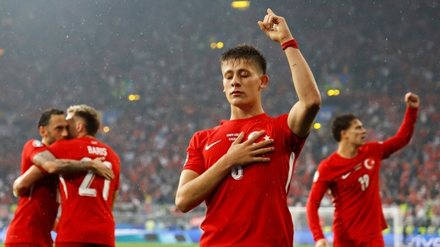

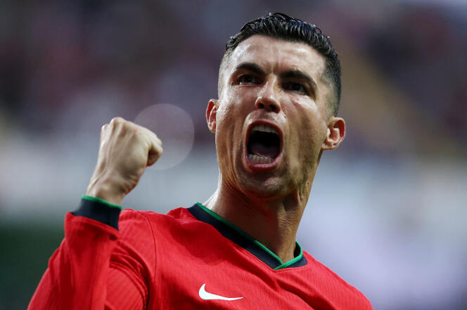
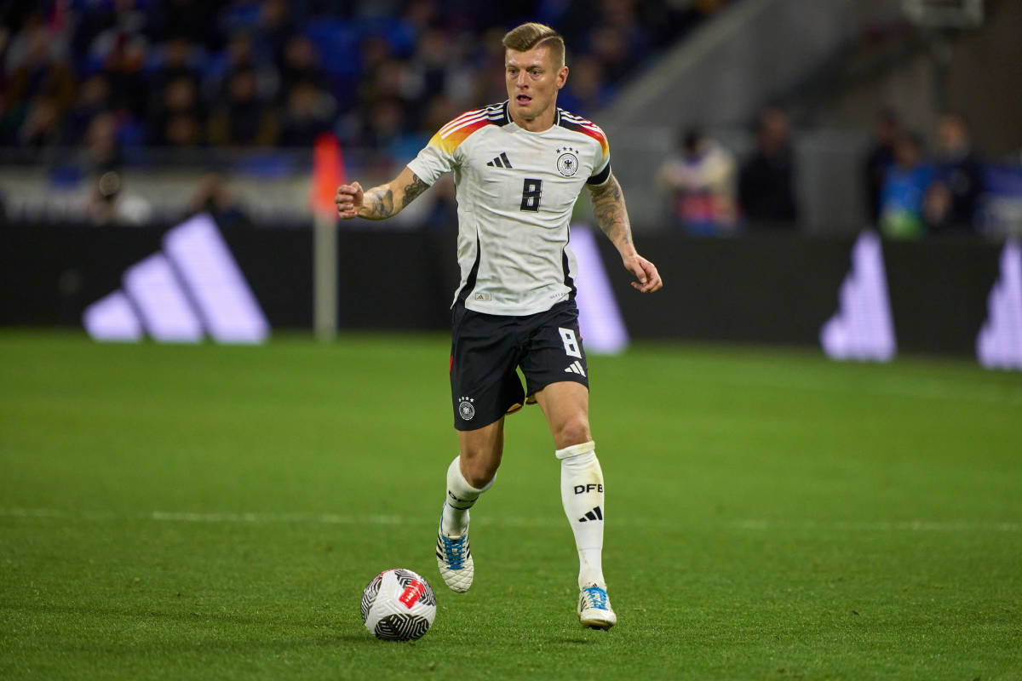
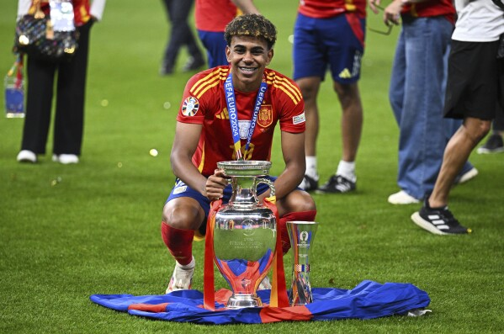
INDEX
ENGLISH OR SPANISH?
DATA
METHODOLOGY
NEXT STEPS
REFERENCES

Slide 3
ENGLISH OR SPANISH?

Slide 4
ITS NOT COMING HOME AGAIN…..
After rigorous calculations and countless simulations, our model predicts that Spain will win the 2024 UEFA Euro by a narrow margin of one goal. A tough and exciting match for both sides!
Model Results
TOTAL POINTS : 86
Phase 1
Type | % | Description
Accuracy | 47% | 17 out of 36 matches correct predicted
Correct goal difference | 59% | 10 out of 17 matches with correct goal difference
Partial goal difference | 24% | 4 out of 17 with partial goal difference
Incorrect goal difference | 18% | 3 out of 17 with incorrect goal difference
Top goal scorer | None | Romelu Lukaku
TOTAL MATCH POINTS : 29 , TOP SCORER POINTS : 0
Phase 2
Type | % | Description
Accuracy | 75% | 9 out of 12 matches correct predicted
Correct goal difference | 22% | 2 out of 9 matches with correct goal difference
Partial goal difference | 42% | 5 out of 9 with partial goal difference
Incorrect goal difference | 36% | 2 out of 9 with incorrect goal difference
Top goal scorer | None | Niclas Füllkrug
TOTAL MATCH POINTS : 27 , TOP SCORER POINTS : 0
Phase 3
Type | % | Description
Accuracy | 100% | 3 out of 3 matches correct predicted
Correct goal difference | 100% | 3 out of 3 matches with correct goal difference
Partial goal difference | 0% | 0 out of 3 with partial goal difference
Incorrect goal difference | 0% | 0 out of 3 with incorrect goal difference
Top goal scorer | None | Jude Bellingham
TOTAL MATCH POINTS : 30 , TOP SCORER POINTS : 0

Slide 5
DATA USED

Slide 6
KAGGLE + WIKIPEDIA + GOOGLE
Kaggle Dataset: International match results from 1872 to 2024
Contains international match results from 1872 to 2024 by MART JÜRISOO . updates every day!
Key columns: date, home_team, away_team, home_score, away_score, tournament, neutral.
DIY Wikipedia Data:
Euro Players Data: Information on players participating in the Euros, including player_name, team, position, goals_scored, appearances. Data is static
Euro Form Data: Team performance metrics, including team, matches_played, wins, draws, losses, goals_for, goals_against, points. Data is static

Slide 7
METHODOLOGY

Slide 8
FLOWCHART
Data
Feature engineering
Model
Results
Update the data based on the phase *
International football results from 1872 to 2024
DIY Wikipedia data
ELO rating for each team
Attack and defense rating for each team
Group stage data
Players data
Filter data with only euros related data (EURO tournaments , qualifications and UEFA nations league)
Filter data for only EURO teams
Euro form calculation
Top 5 Goals/ caps per team
Adjusted Goals using regression
Expected Goals and poison distribution
Only change the fixtures for each phase
Only for phase 2 and phase 3*. No Euro form multiplier for phase 1
Match outcome + goals scored by team(rounded off expected goals). In case of draw the team with higher expected goals wins penalty by 1 goal ( phase 2 & 3)
Top scorer

Slide 9
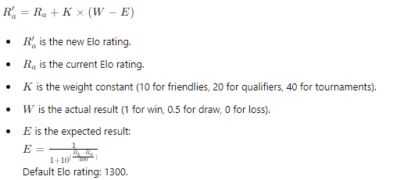


SCIENCE + FOOTBALL = WINNING FORMULA
Elo Calculation:
All teams get ELO rating. After each match the ELO rating will get updated based on the type of match and difference of actual result and expected result. In Elo formula, the difference is between the two teams for expected result
Formula:
Team attack and defense calculation:
All teams get Attack and defense rating. After each match the Attack and defense will get updated based on the type of match and difference of actual goals and expected goals
Formula:
Expected Goals Using Poisson Distribution with historical international data
The Poisson distribution is used to model the number of goals scored in a match. It is based on the expected number of goals a team is expected to score. The final score is rounded by expected goals
Incase a match ends in a draw, the team with the higher expected goal would wins the penalties with a goal difference of 1
Formula:
Did You Know?
Copa America: No qualification rounds! All 10 teams are automatically eligible. Imagine a football tournament where everyone gets a golden ticket!

Slide 10


SCIENCE + FOOTBALL = WINNING FORMULA
Adjusted Goals Using Elo Regression with European performance :
The Final goals scored by each team is determined by adding the expected goals and Adjusted goals
Target variable is the Adjusted goals (difference between goals scored and average goals scored by each team ), the independent variable is the ELO difference between both the teams
Since its variable difference between goals scored and average goals, the regression can give negative results which could result in a result in a negative final score. To avoid this we add the modulus of negative value to both the teams Eg: Spain:3 – Georgia -1 would finally be Spain:4 – Georgia:0
Euro form multiplier with EURO 24 group stage data:
The expected goals is updated by multiplying with the current euro form. The current euro form was calculated using the points scored in group stage. The euro form is the Points scored by team by the median points scored by all European teams
This is only applicable for phase 2 and phase 3, this increased the accuracy from 47% to 75% from phase 1 to phase 2
Formula:
Top Goal scorer
All the players from each team, goals ,and cap are taken into account to calculate Goal per caps. Top 5 players Goals per caps are chosen from each. The total goals scored by each team using the match prediction model is redistributed among the top 5 players for each. This method ensures we have the top goal scorer based on the team perforo
dfdgg
Did You Know?
Maximum games team can play in one euro tournament (tournament + qualifications)~19
Maximum games team can play in one nationals ~8
UEFA tournaments since 2010 is 3
UEFA Nations league since 2010 is 3
Total maximum matches = (19 x 3) + (8 x 3) =81 matches

Slide 11
NEXT STEPS

Slide 12
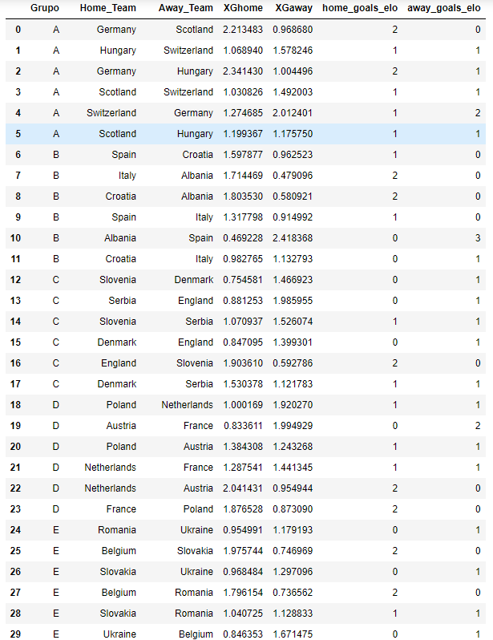
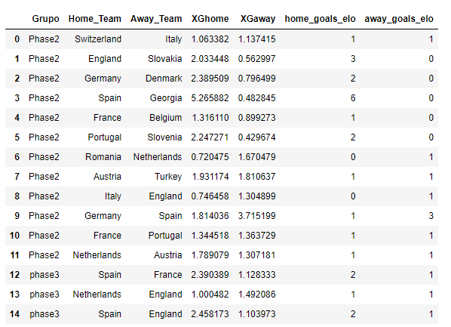
UNTIL NEXT TIME…
Model Improvements:
Continuous updates and more granular data will make future predictions even more accurate. It’s like fine wine, only better with time.
Need to work on top goal scorer

Slide 13
APPENDIX

Slide 14
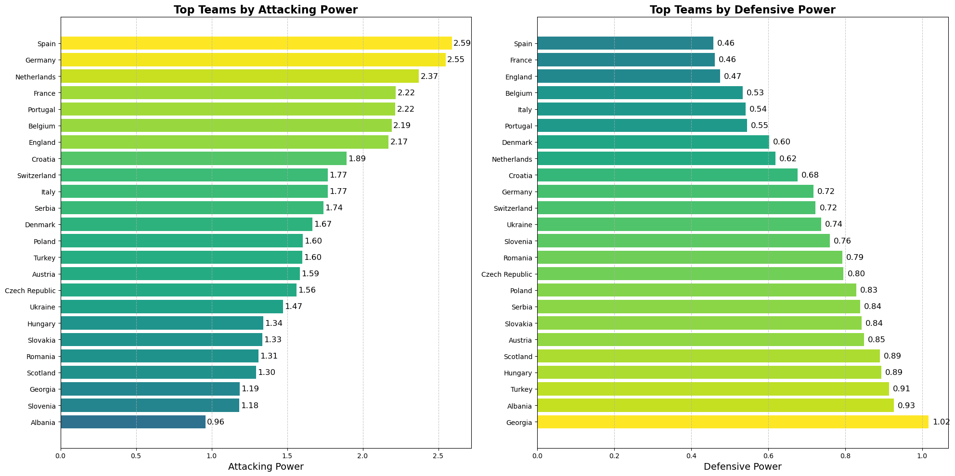
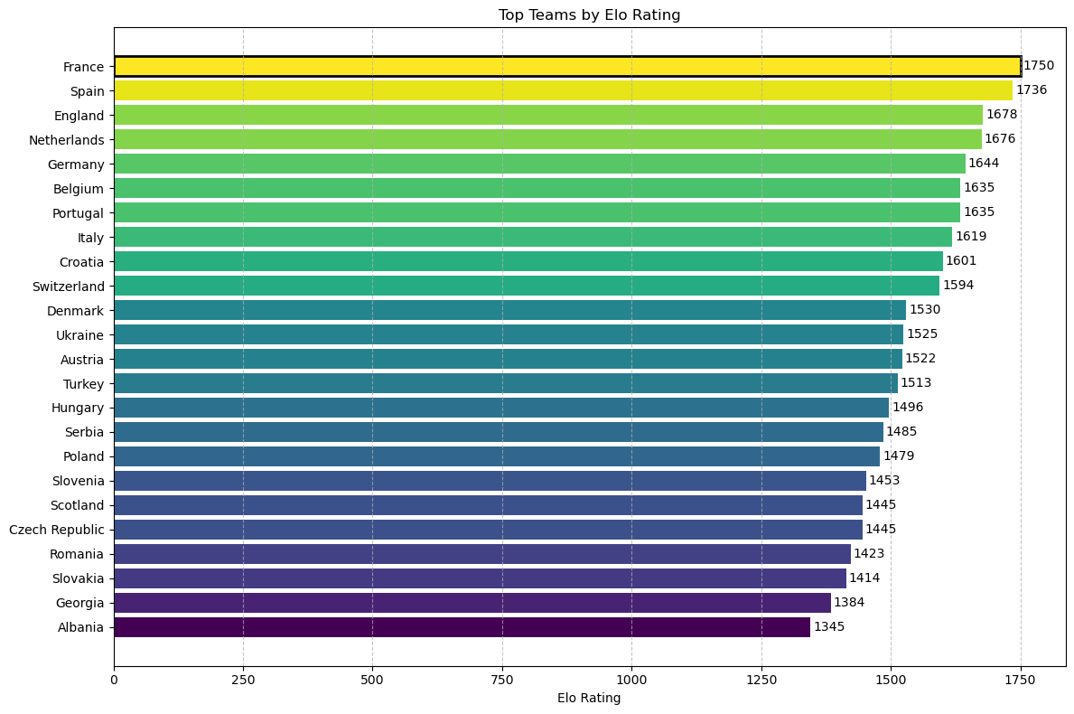
ELO , ATT & DEF

Slide 15
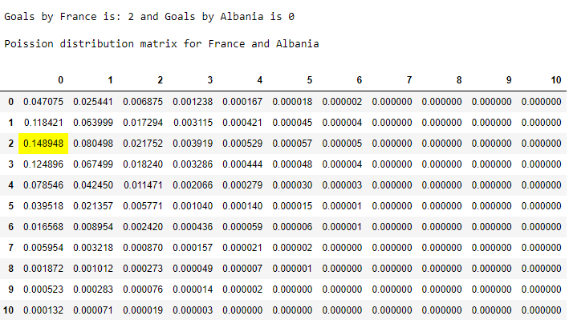
POISSON MATRIX

